Slide 1
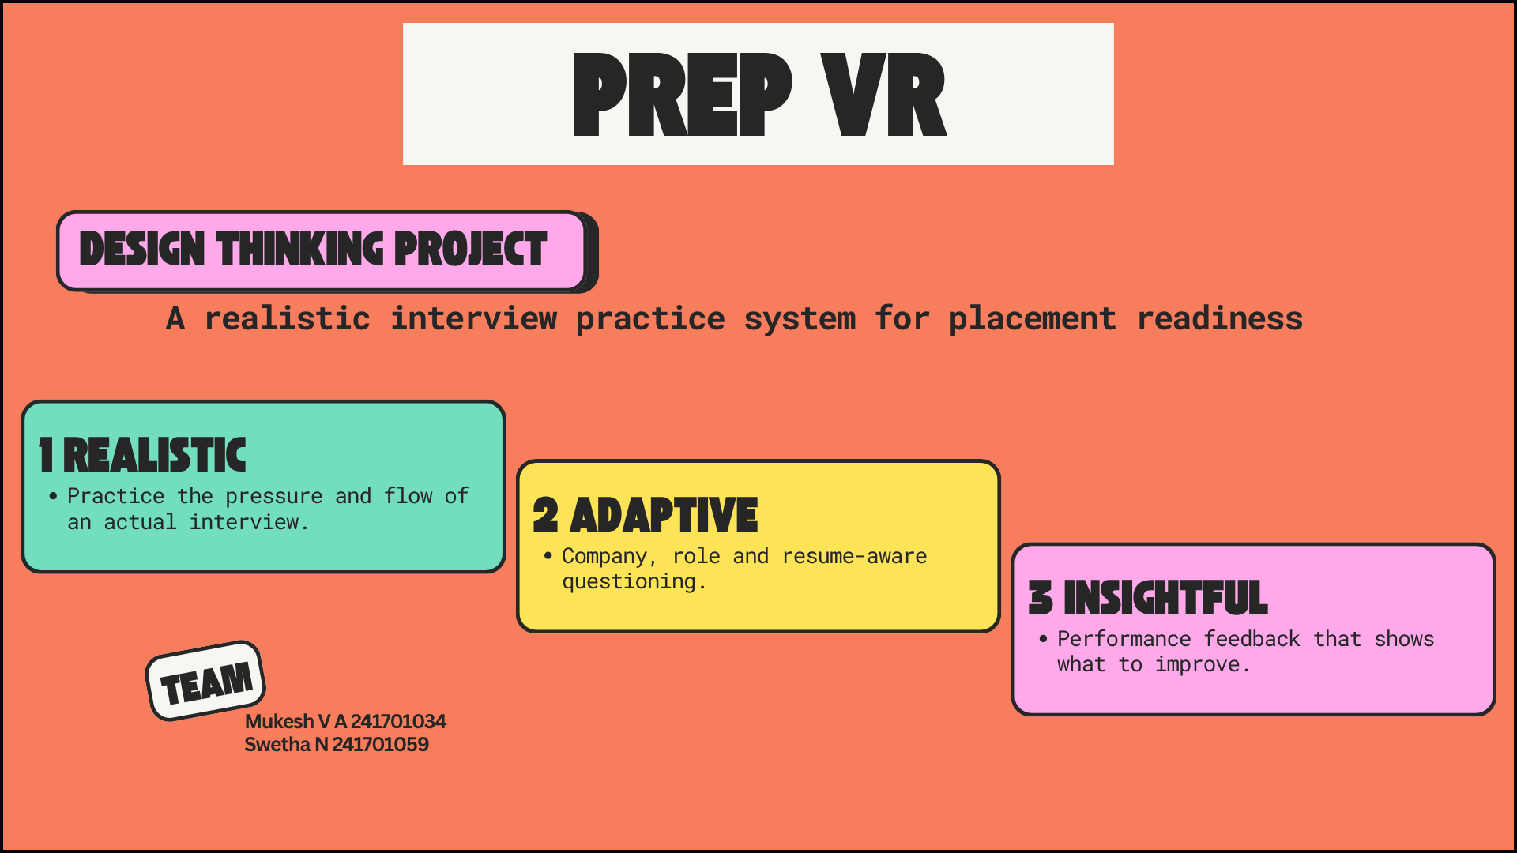
MS INNOVATE • DESIGN THINKING & INNOVATION

Slide 2
01 • CONTEXT
02
PROBLEM DEFINITION
1 CURRENT SITUATION
2 SYSTEM-LEVEL GAP
• Students prepare using videos, online platforms, self-practice and peers.
• Many students still feel nervous during interviews.
• Realistic mock interview opportunities are limited.
• Feedback after practice is often limited or generic.
• Existing resources teach preparation, but do not fully simulate the interview experience.
• Students need practice with technical, behavioral and follow-up questions.
• Placement faculty need better visibility into student performance.
• Company and role differences are not always reflected in practice.
THE WHY
MS INNOVATE • DESIGN THINKING & INNOVATION

Slide 3
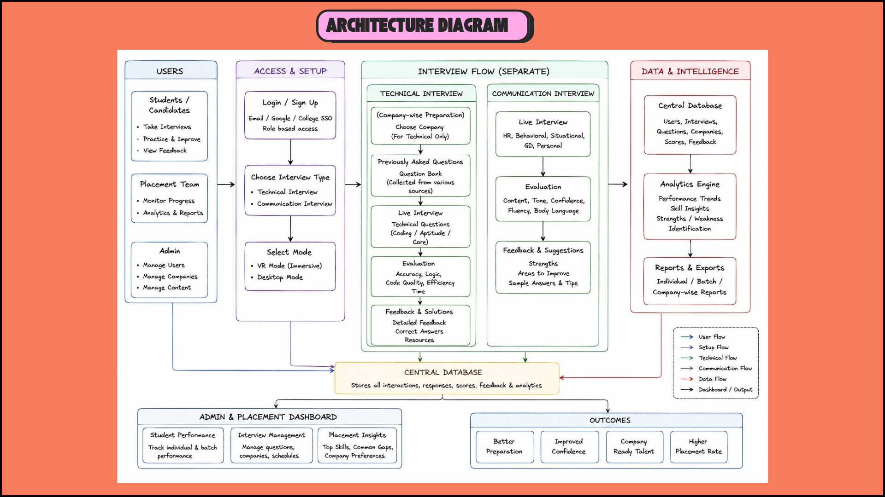
02 • DIAGRAM
MS INNOVATE • DESIGN THINKING & INNOVATION

Slide 4
03 • OBJECTIVES
OBJECTIVES
GOALS
INTENDED OUTCOMES
1
Provide realistic AR/VR interview practice.
CONFIDENCE
Students become more comfortable facing interviews.
2
Support company, role and resume-based questions.
READINESS
Practice reflects real interview conditions.
3
Generate natural follow-up questions.
INSIGHT
Evaluate technical and communication performance.
Students understand strengths and improvement areas.
4
VISIBILITY
5
Provide actionable feedback for improvement.
Faculty can review student performance and progress.
SUCCESS = PRACTICE + FEEDBACK + READINESS
MS INNOVATE • DESIGN THINKING & INNOVATION

Slide 5
04 • CONSTRAINTS
CONSTRAINTS
1 HARDWARE
2 USABILITY
VR headsets may not be available to every student.
Students may have different levels of AR/VR familiarity.
3 AI ACCURACY
4 TIME & BUDGET
Generated questions and feedback need validation.
A student project limits implementation and testing scope.
5 PRIVACY
6 ACCESS
Resume and performance data must be handled securely.
The experience should have a practical non-VR fallback.
MS INNOVATE • DESIGN THINKING & INNOVATION

Slide 6
05 • SCOPE
06
WHERE THE DESIGN CAN EVOLVE
1 INTERVIEW MODE
2 QUESTION MODE
3 FEEDBACK MODE
4 FACULTY MODE
AR/VR immersive interview
Web/desktop fallback
Company • Role • Resume
Adaptive follow-up
Technical • Communication
Confidence • Overall
Performance dashboard
Readiness tracking
EXPLORE → VALIDATE → DECIDE
MS INNOVATE • DESIGN THINKING & INNOVATION

Slide 7
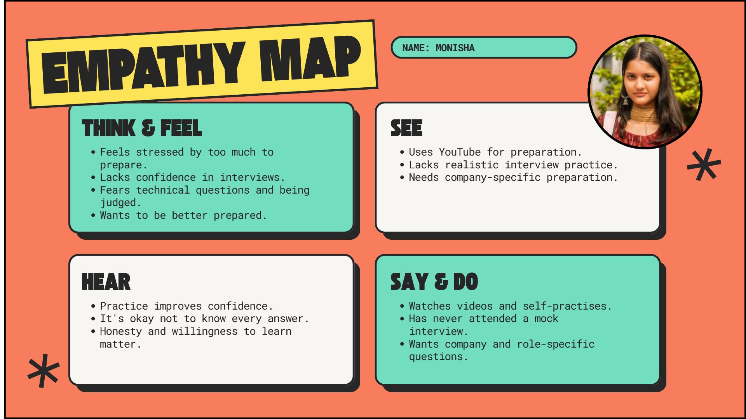
06 • EMPATHY
PASSED OUT STUDENT
MS INNOVATE • DESIGN THINKING & INNOVATION

Slide 8
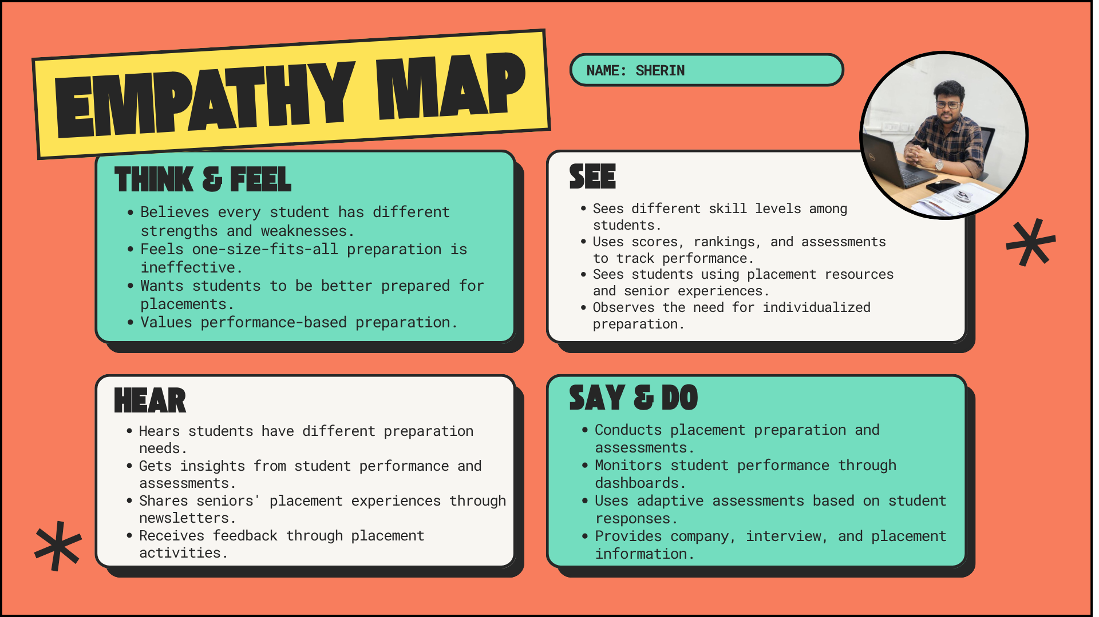
07 • EMPATHY
PLACEMENT FACULTY
MS INNOVATE • DESIGN THINKING & INNOVATION

Slide 9
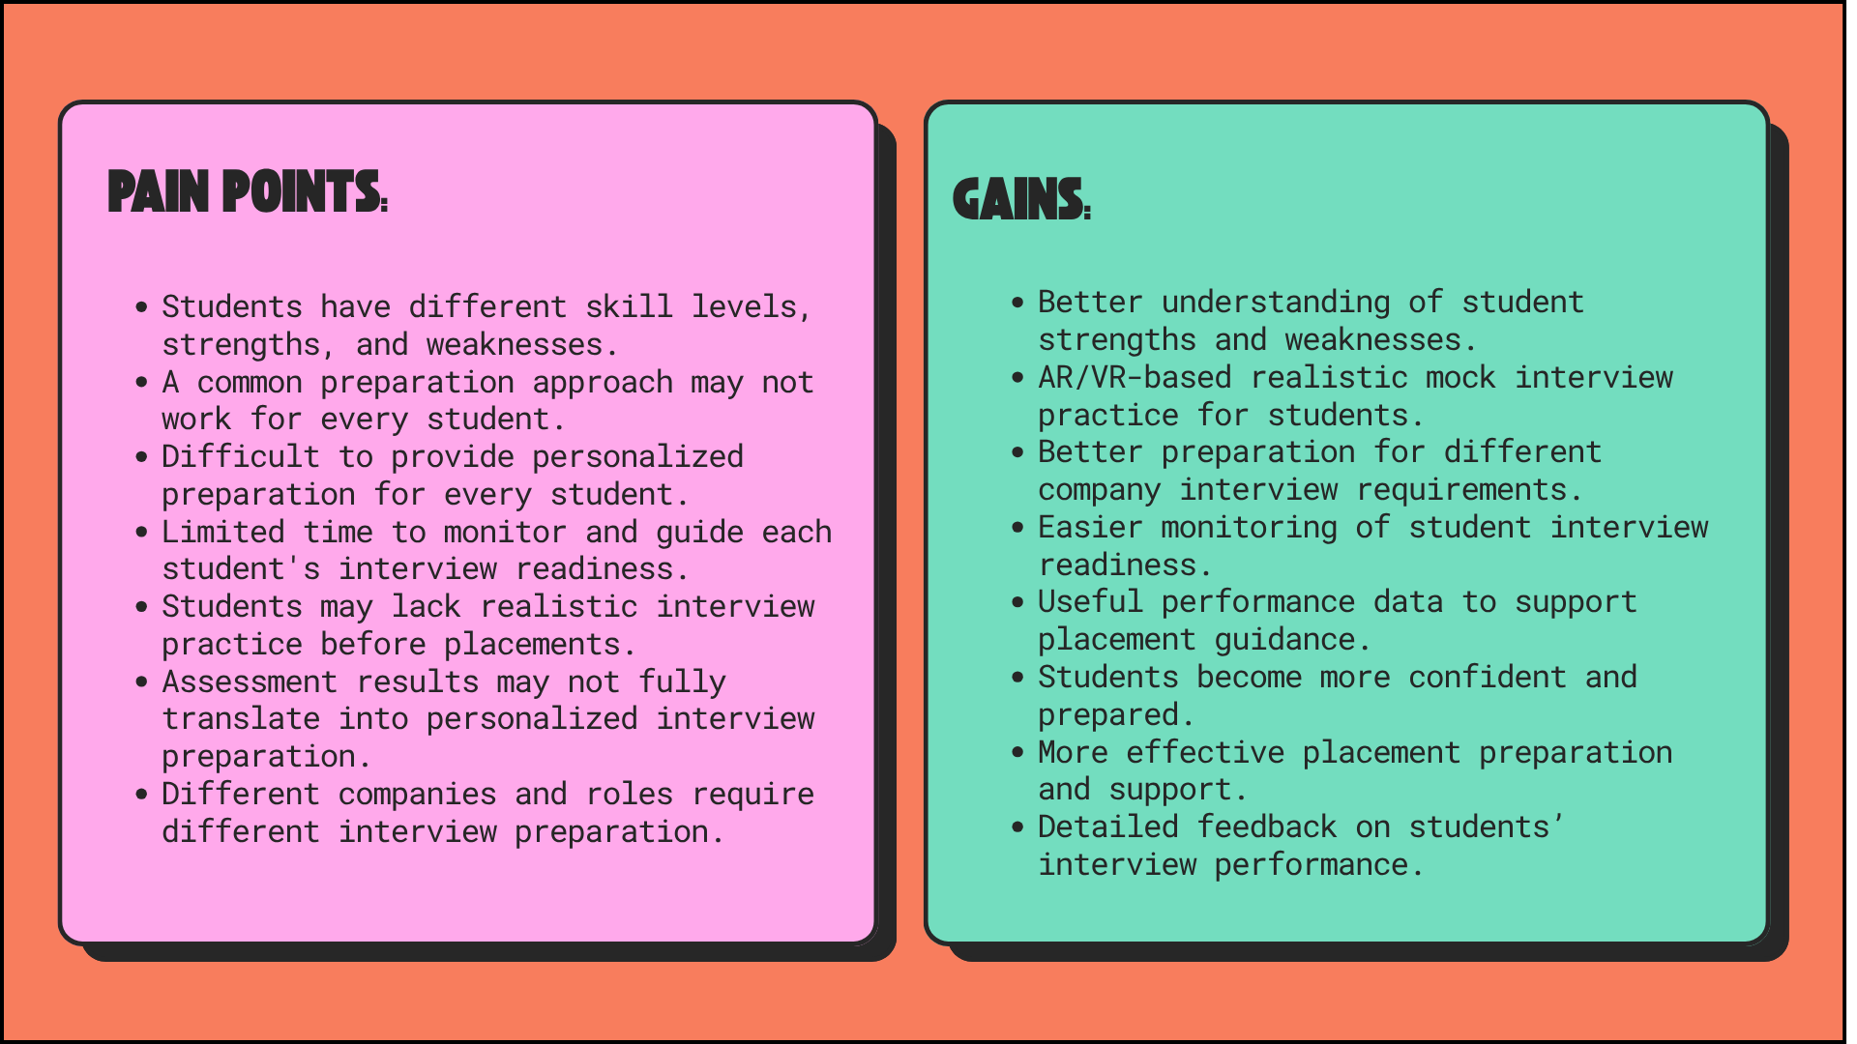
08 • PAIN & GAIN
MS INNOVATE • DESIGN THINKING & INNOVATION

Slide 10
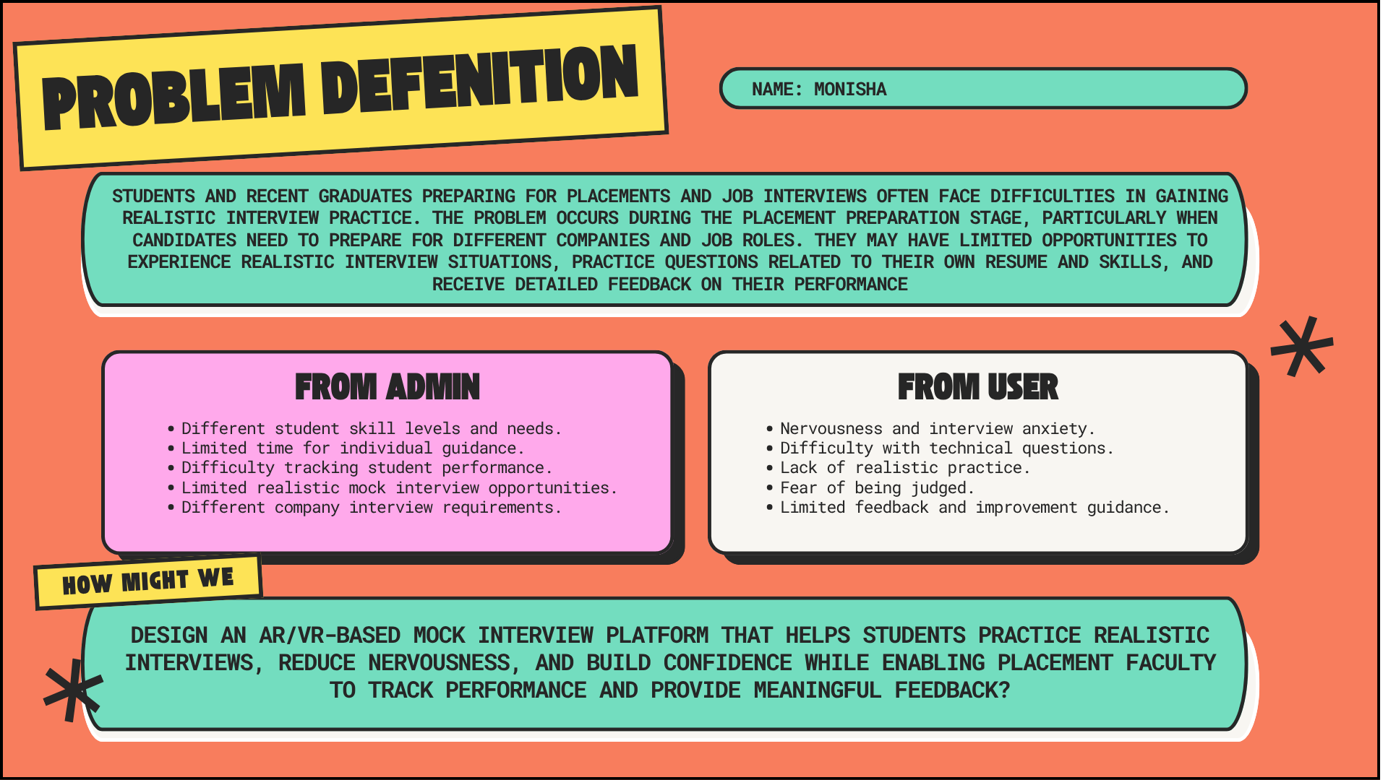
09 • PROBLEM DEFINITION
MS INNOVATE • DESIGN THINKING & INNOVATION

Slide 11
10 • USER FLOW
11
USER FLOW
1
2
3
4
5
LOGIN
SELECT
PREPARE
INTERVIEW
FEEDBACK
Access profile and previous performance.
Choose company, role and interview type.
Upload/select resume and interview context.
Enter VR environment and answer questions.
Review scores, feedback and improvement areas.
CORE IDEA
Move interview practice closer to the real experience, then turn each session into actionable improvement.
MS INNOVATE • DESIGN THINKING & INNOVATION

Slide 12
11 • DESIGN OUTCOMES
12
DESIGN OUTCOMES
DESIGN & PROTOTYPING
RESEARCH
VR interview environment • UI/UX prototype • Student and faculty flows
Student surveys • Placement faculty interview • Empathy maps • Existing-platform study
TESTING
ACCESS
Usability testing • Mock interview trials • Feedback validation • Iterative refinement
VR headset • Laptop/desktop fallback • Internet • Secure student data
ITERATE → TEST → DOCUMENT → REFINE
MS INNOVATE • DESIGN THINKING & INNOVATION

Slide 13
12 • CONCLUSION
A realistic interview experience designed around practice, feedback and readiness
HOW MIGHT WE...
How might we design an VR-based mock interview platform that gives students realistic, company- and role-specific interview practice, adaptive follow-up questions and meaningful feedback while helping placement faculty understand student performance?
REALISTIC PRACTICE
SMART FEEDBACK
PLACEMENT READINESS
VR • ADAPTIVE INTERVIEW • FEEDBACK • READINESS
THANK YOU
MS INNOVATE • DESIGN THINKING & INNOVATION

